Slide 1
Common Icons
T&O Innovation

Slide 2






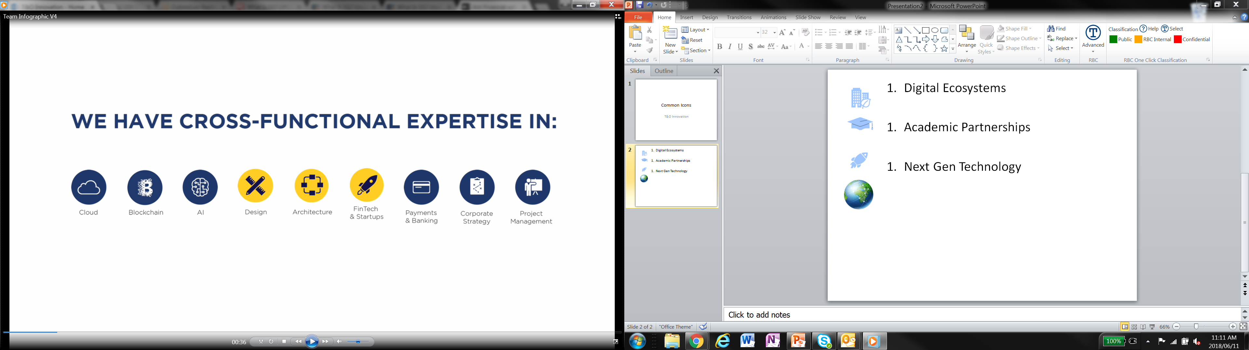


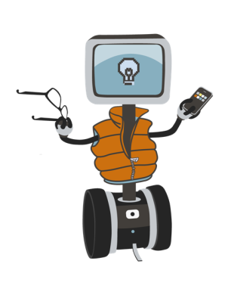
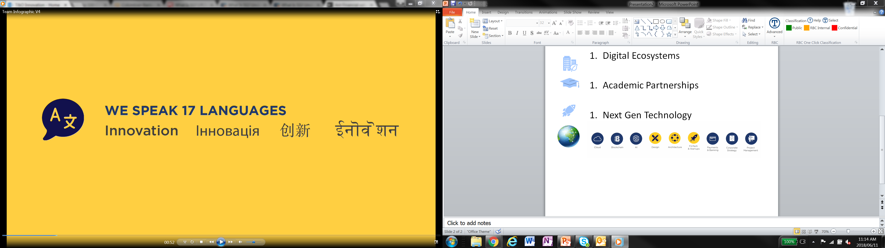

Digital Ecosystems
Academic Partnerships
Next Gen Technology
Education/Partnerships
Isogenies/ algorithms
Blackhat
Innovation

Slide 3


















Proof of Concepts
Partnerships
newsletters
Client facing
Data/Systems
Centers of Excellence
Authentication
Data Aggregation
Consultation Services
Maps/Planning
Income Verification
Forums/Discussions
Real time adjudication
Booking/Organization
Presentations
Funding
Time/Planning

Slide 4
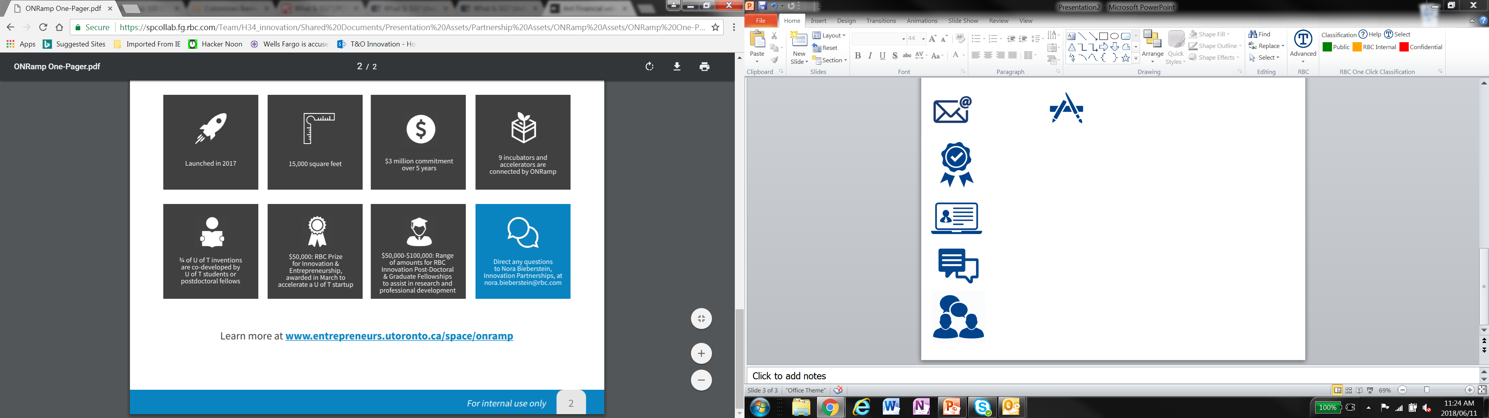
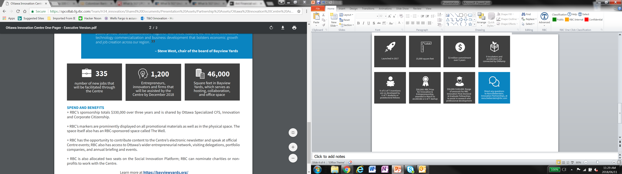
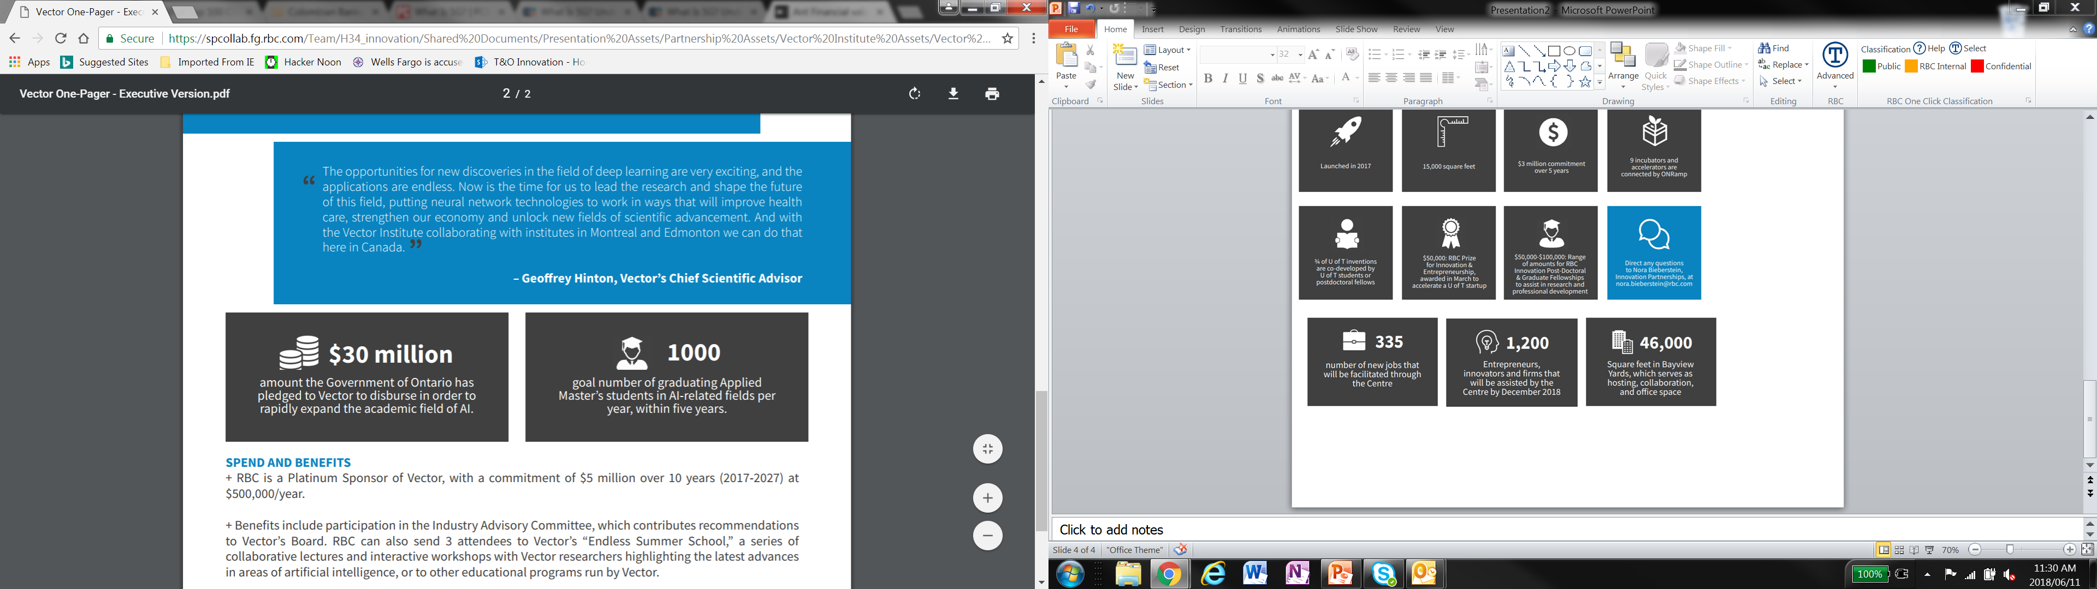

Slide 5
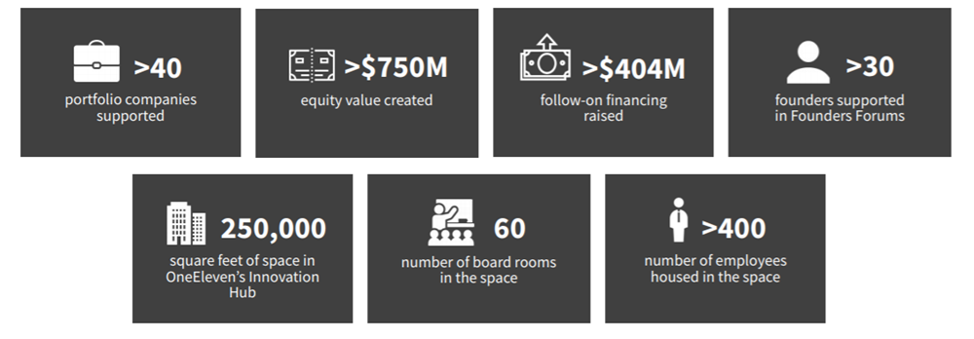
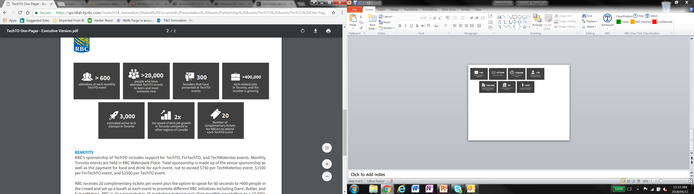
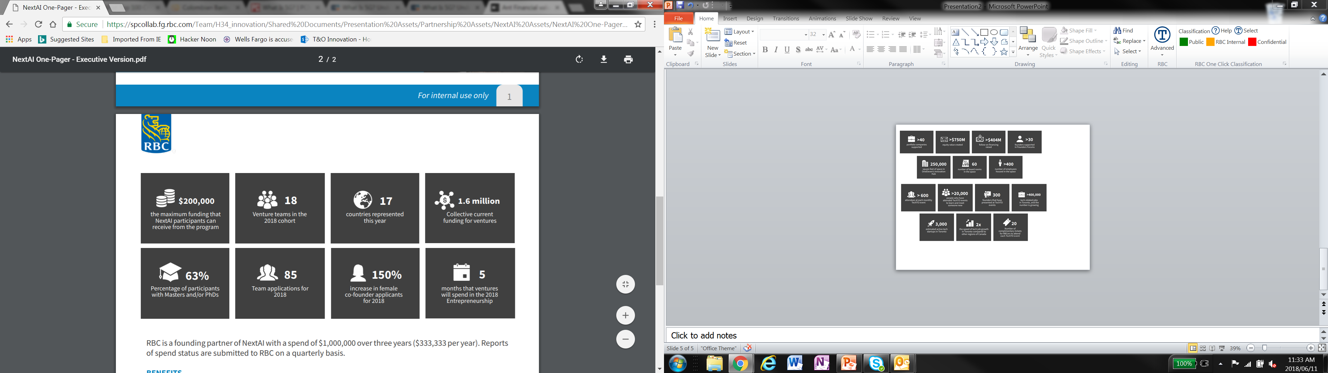

Slide 6
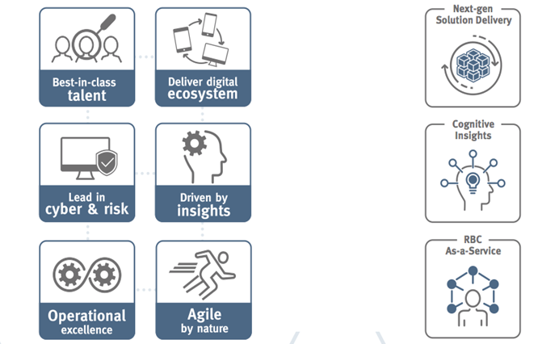










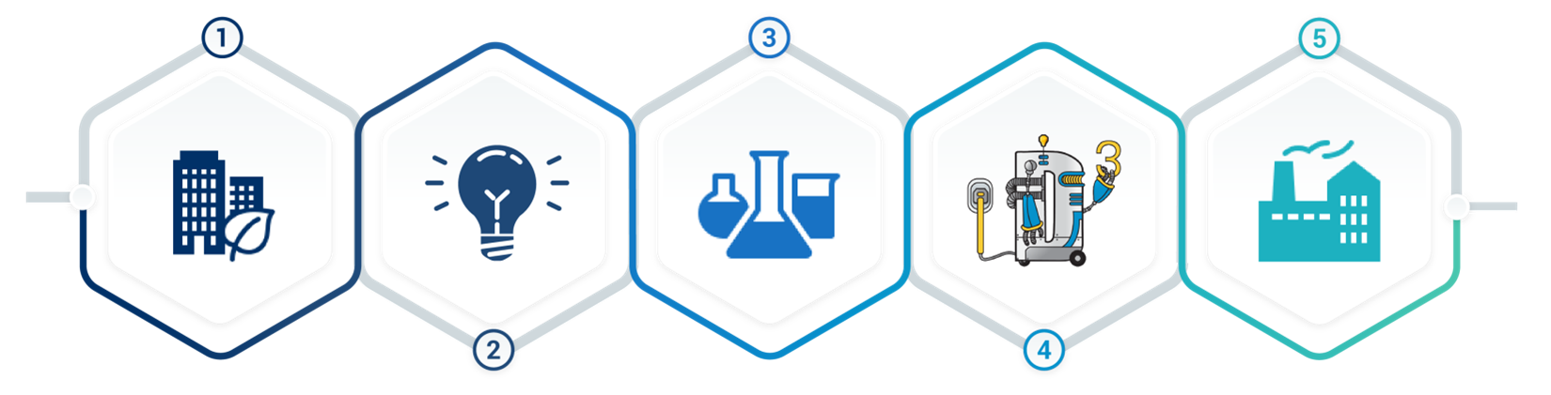
Incubation
Ecosystems
Proof of Concepts
Ideas
Targets
Project Completion
Sponsor
Planning/Organization
Process work
Mobile Platforms
Ecosystems/internal
Fresh thinking
Start-up labs, proof of concepts
Design develop, deliver
Production

